Slide 1

Capstone Project Presentation “Travel App & Code Playground App”
Submitted by :
Name : Yemula Sai Satya
LMS Id:- MGSA_535

Slide 2

CONTENTS
INTRODUCTION OF TRAVEL APPROVAL APP
Flow Chart
MODULE 1
MODULE 2
CONCLUSION

Slide 3
INTRODUCTION OF TRAVEL APPROVAL APP
The travel approval project in Salesforce is a system designed to automate and streamline the process of requesting and approving travel expenses for employees. The project involves several components, including a custom object to track travel requests, a custom approval process, and various integrations with external systems.
Overall, the travel approval project in Salesforce provides a streamlined and efficient way for employees to request and manage travel expenses, while also providing managers with the tools they need to ensure that all expenses are approved and accounted for.

Slide 4
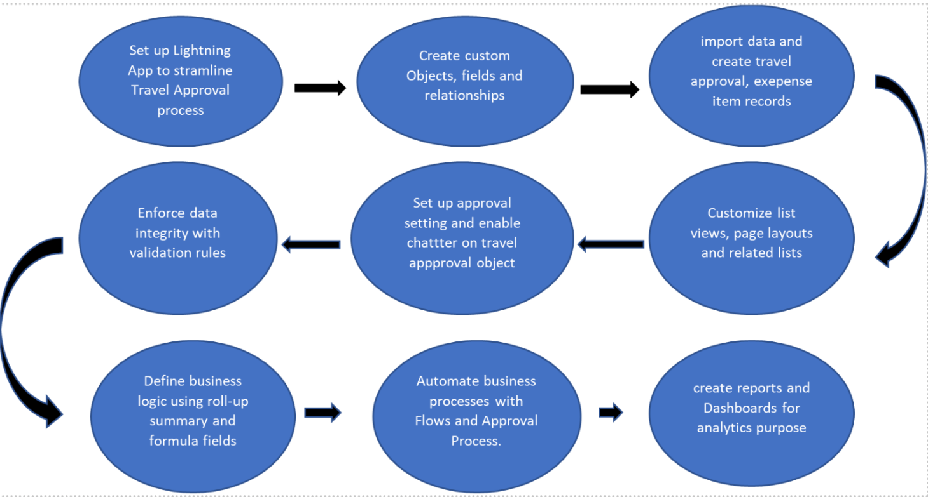
Flow of the Project:

Slide 5
Module -1
In This module we will create Travel Custom App, Objects, Fields & Relationships, and customize the App using Declarative tools.
By end of this module we have working prototype of Travel Approval Application.

Slide 6
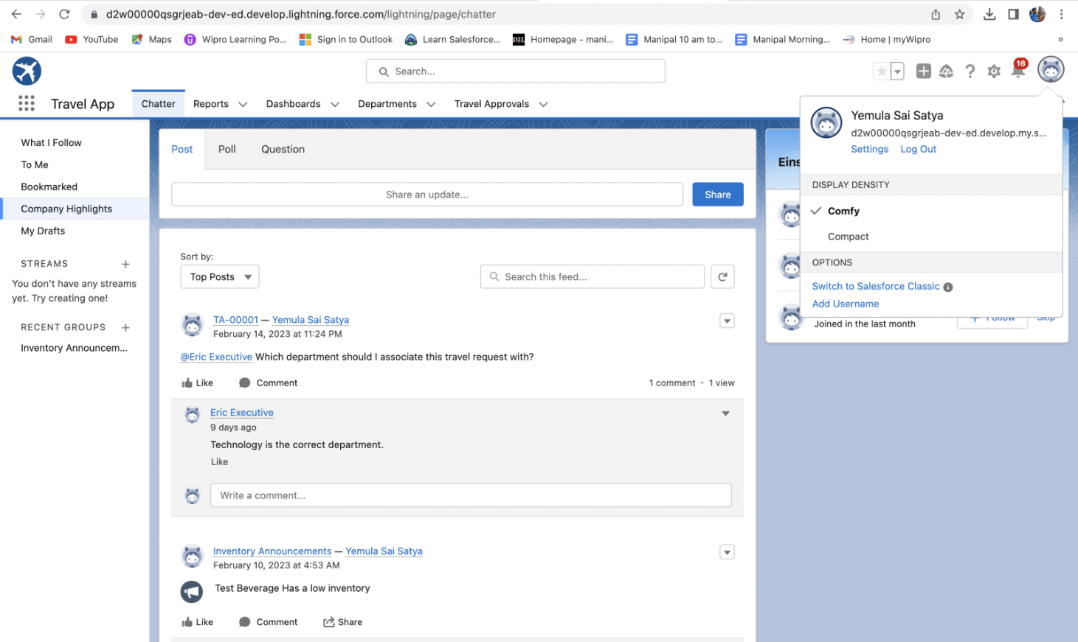
Created Custom lightning App “ Travel App”.

Slide 7
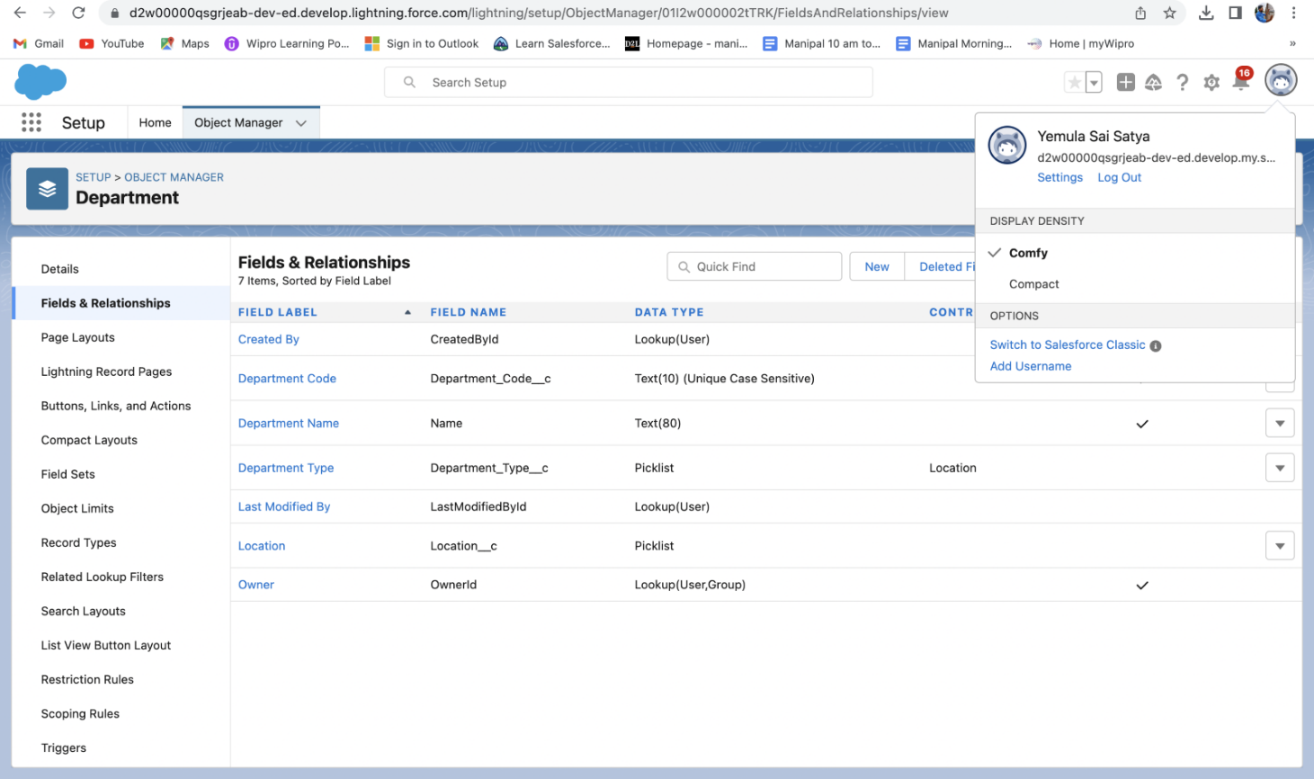
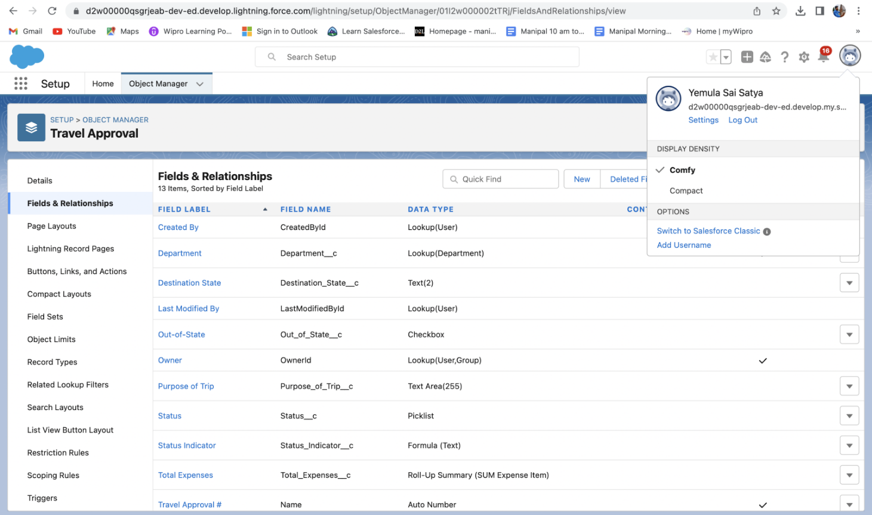
Created Department and Travel Approval custom objects and respective fields.

Slide 8
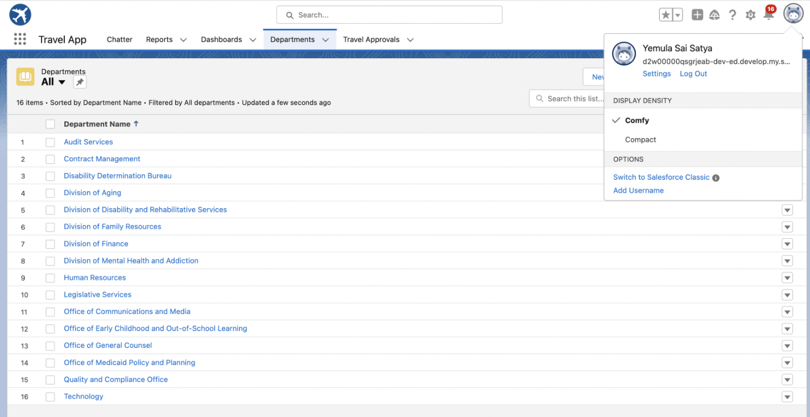
Imported the data from departments.csv file

Slide 9
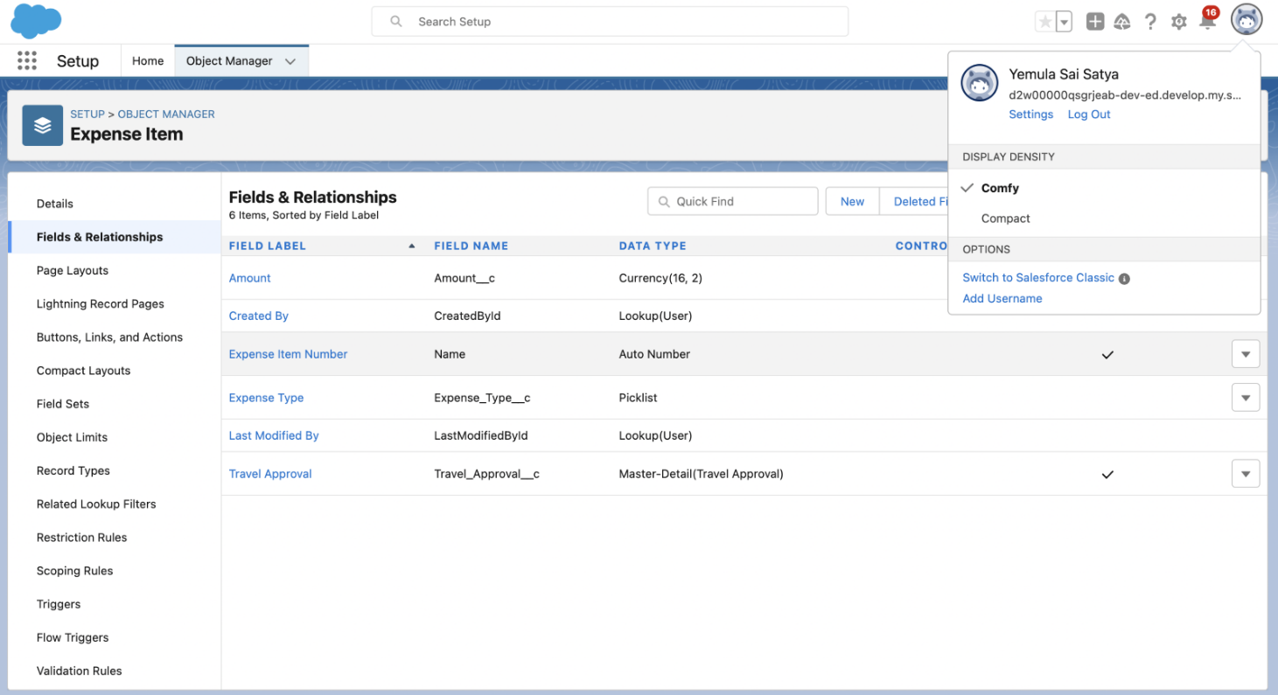
Created Expense Item Custom Object and respective fields

Slide 10
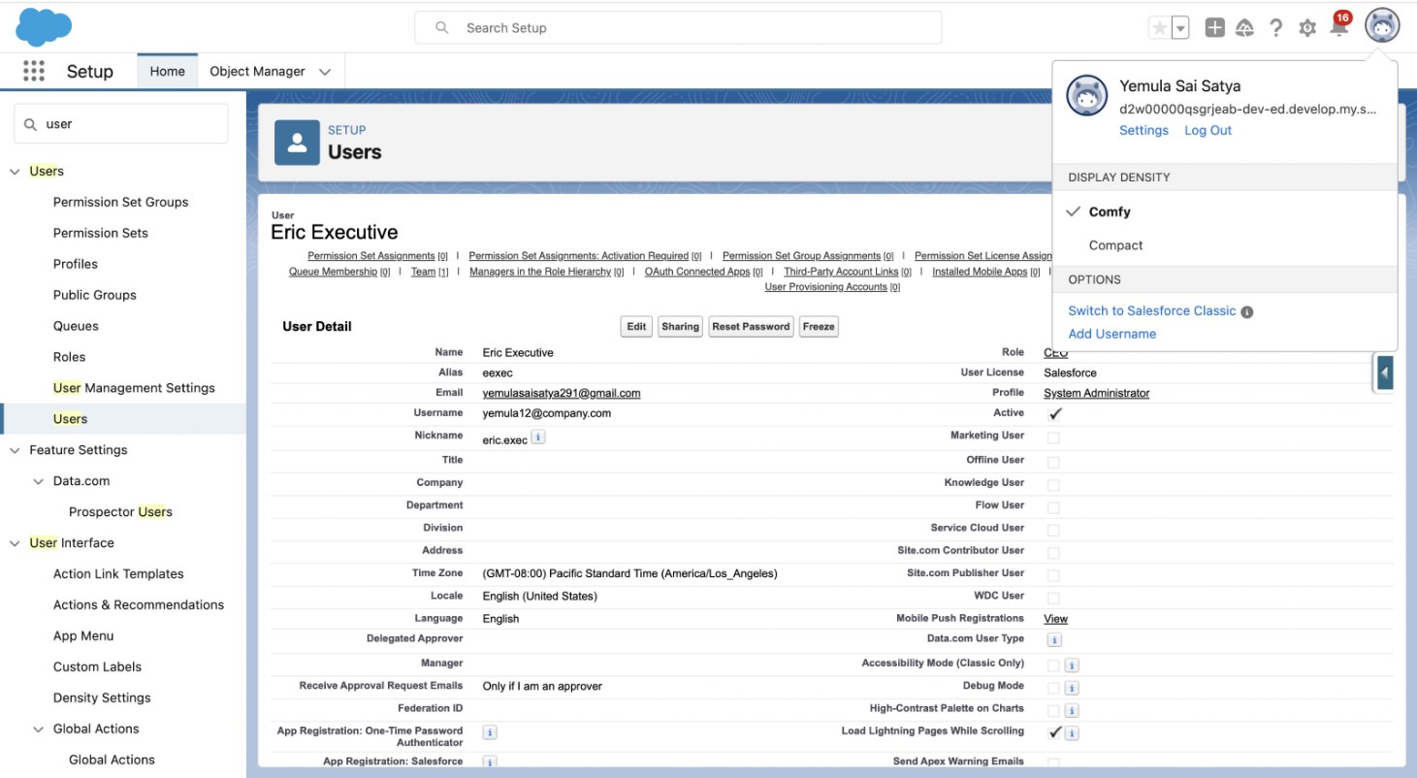
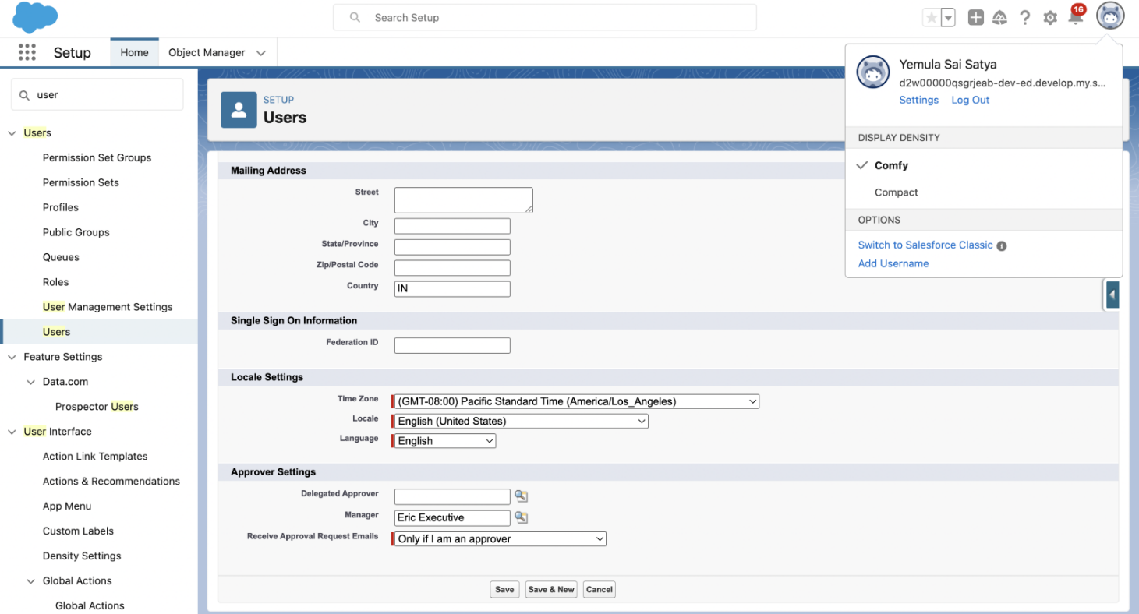
Created User Eric Executive and added as manager for me.

Slide 11
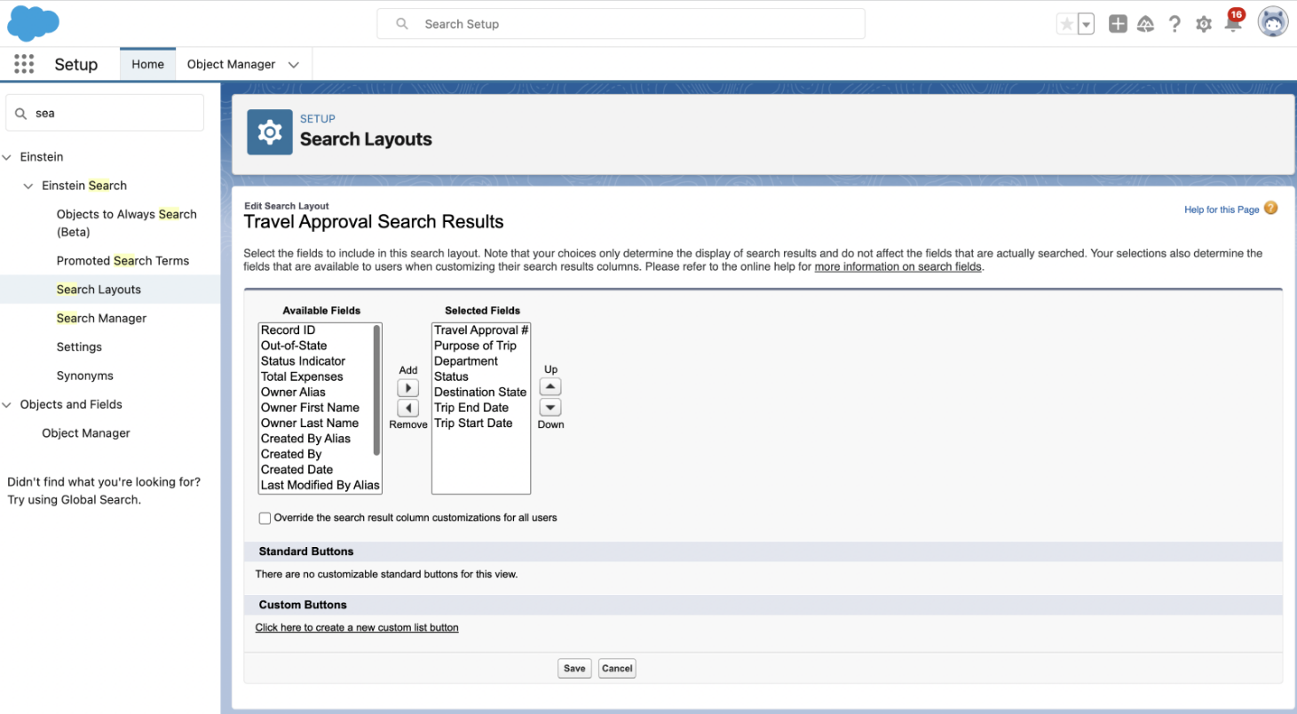
Customized the travel approval default search layout and list view

Slide 12
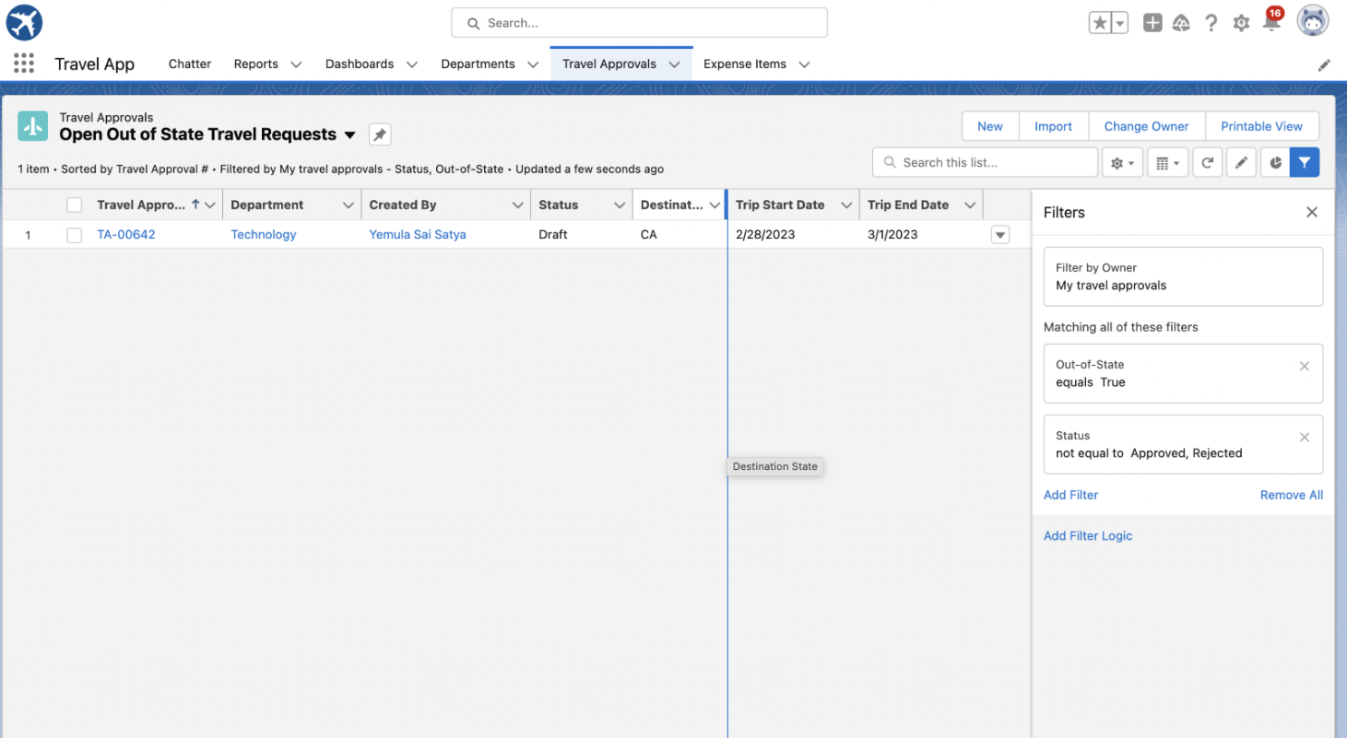
Created custom list view i.e open out of state travel requests

Slide 13
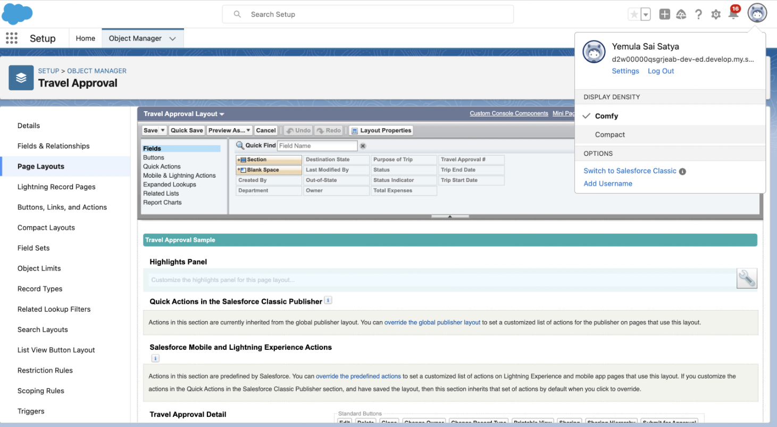
Customized the travel approval page layout

Slide 14
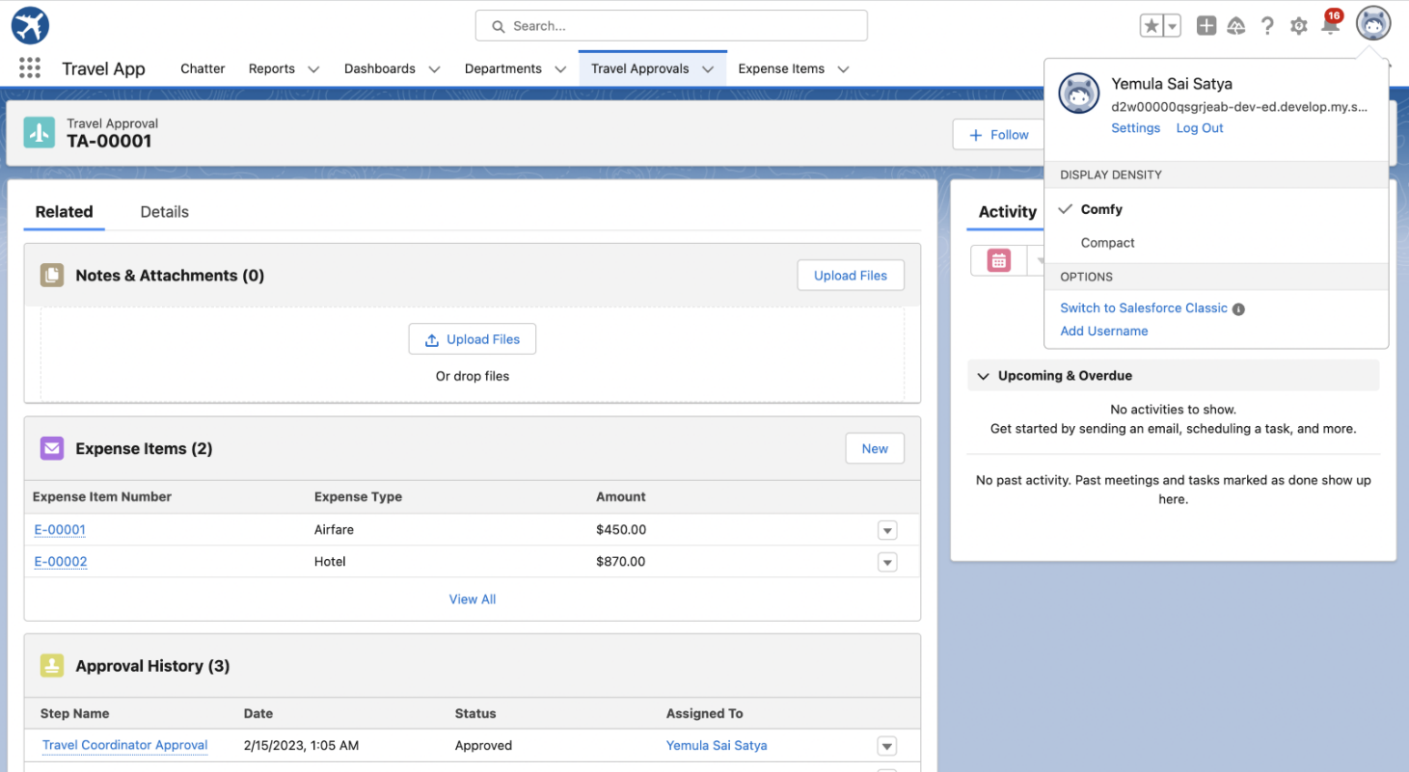
Created Travel Approval and Expense Item records

Slide 15
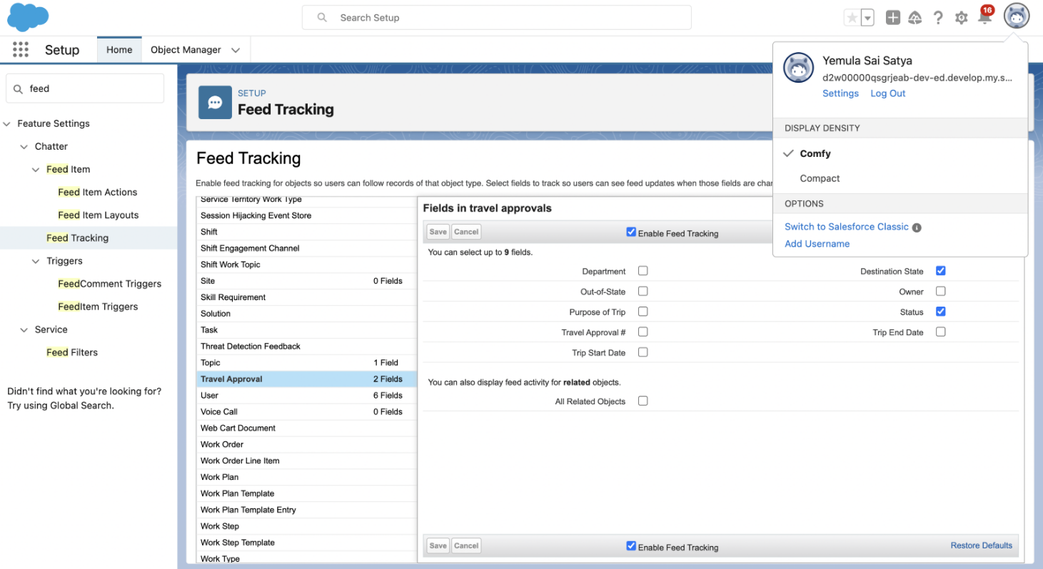
Enable Feed Tracking:

Slide 16
Module – 2:
In this module we add business logic and analytics to the travel approval app to improve user experience.
validation rules to enforce data integrity.
Automated the business process with flows.

Slide 17
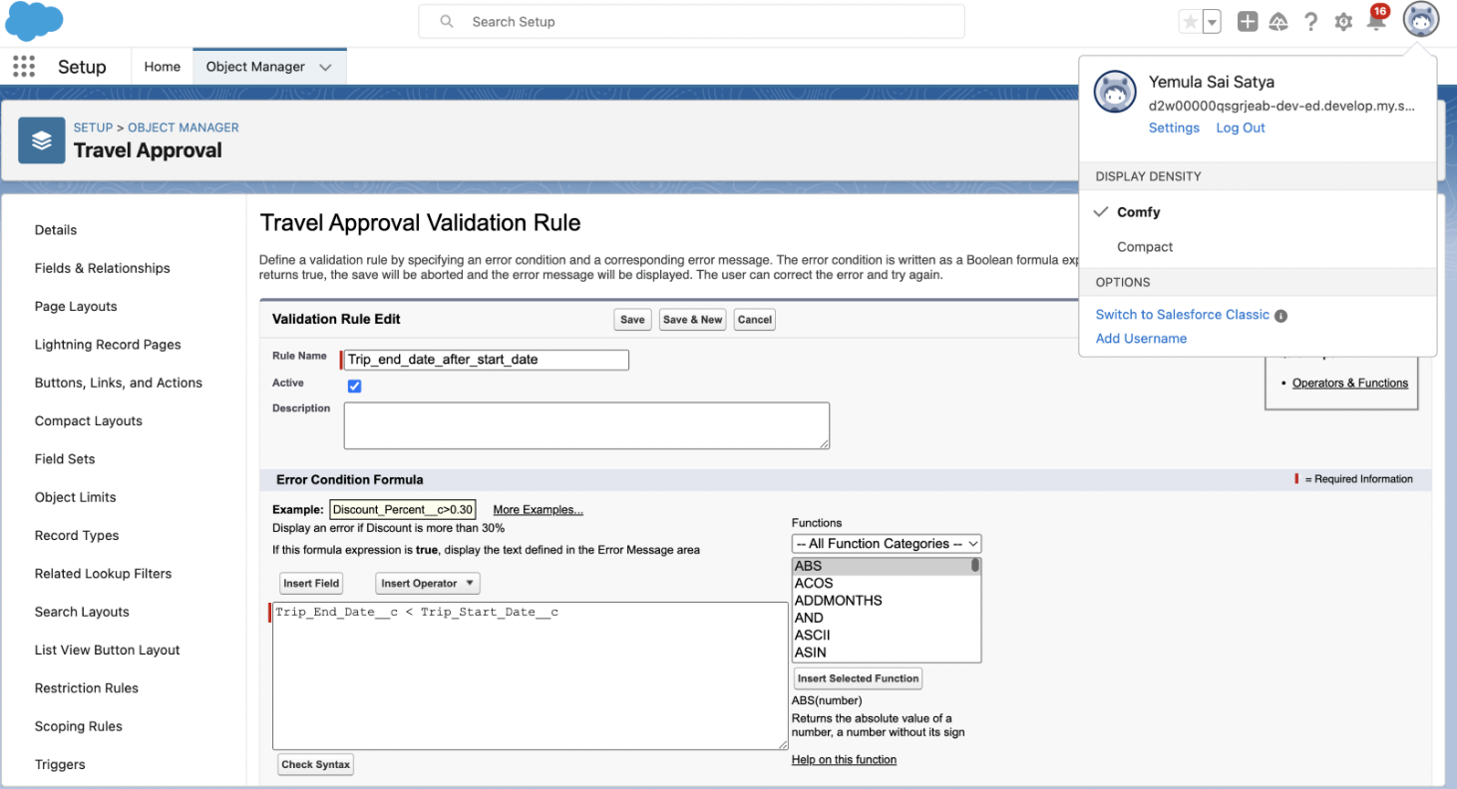
Validation rule to ensure Trip end date > Trip Start date

Slide 18
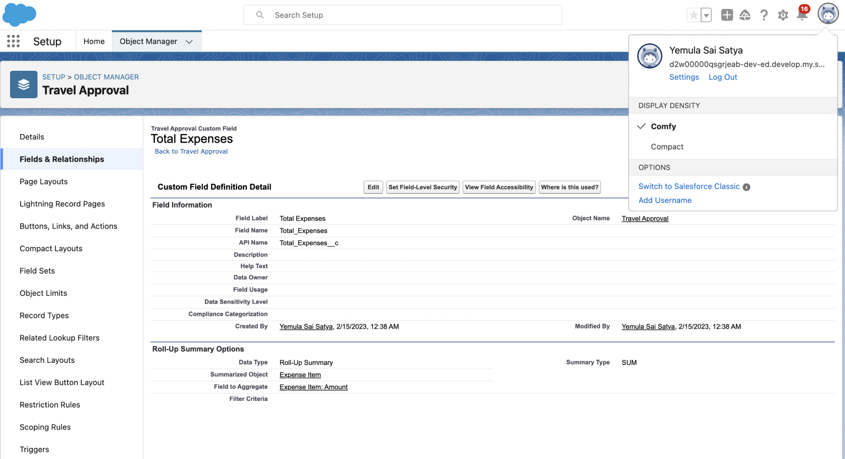
Roll-Up summary field on Travel approval object

Slide 19
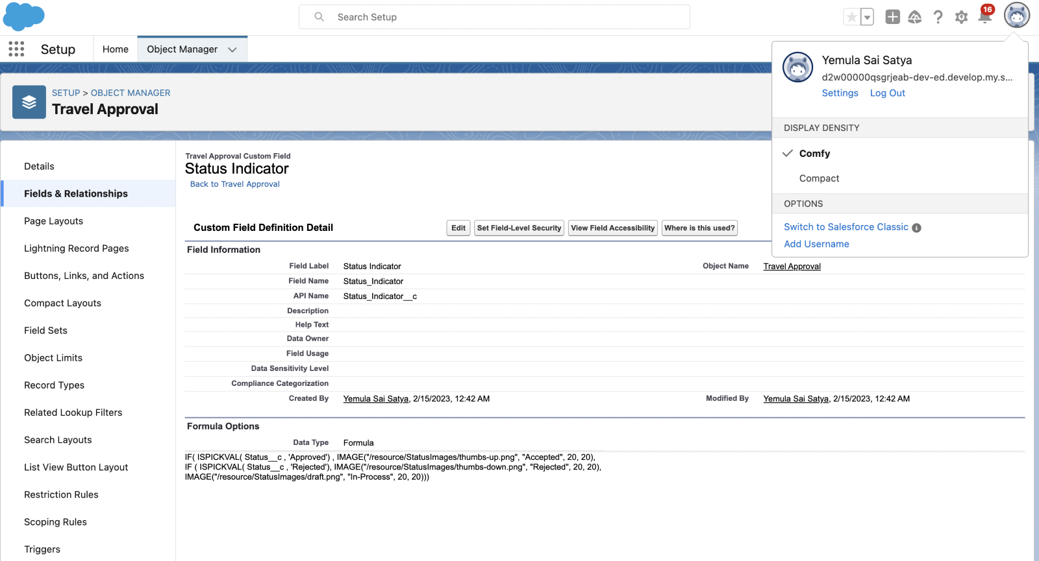
Formula field to show Image based on status field on travel approval object

Slide 20
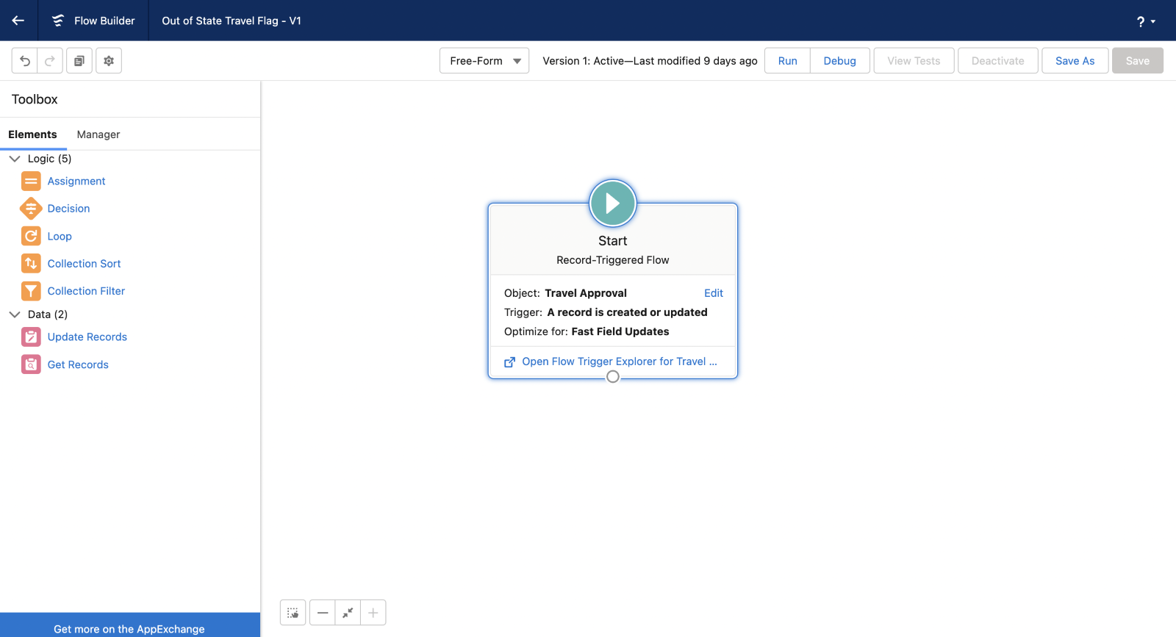
Created Out of state Travel Flag record triggered flow.

Slide 21
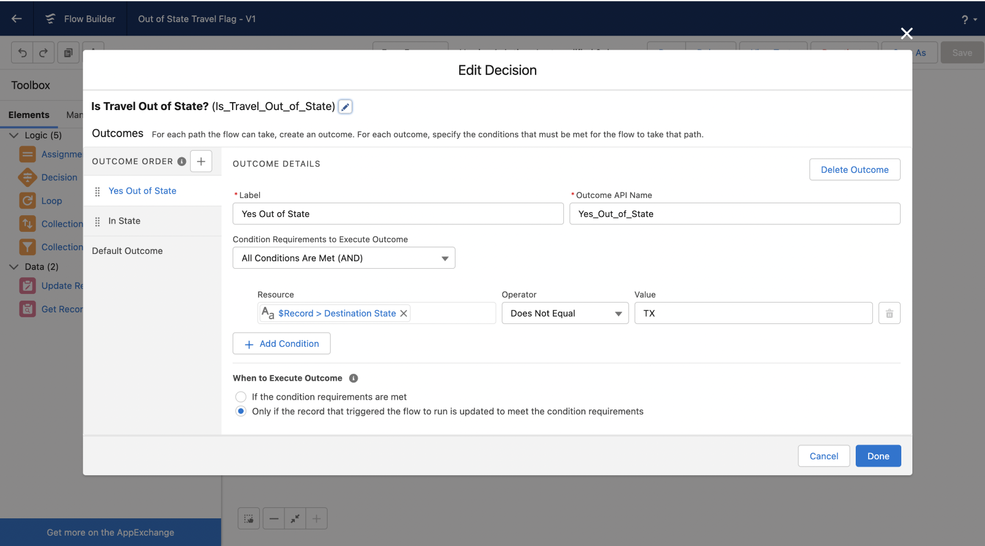
Add Decision element to check the state is in or out

Slide 22
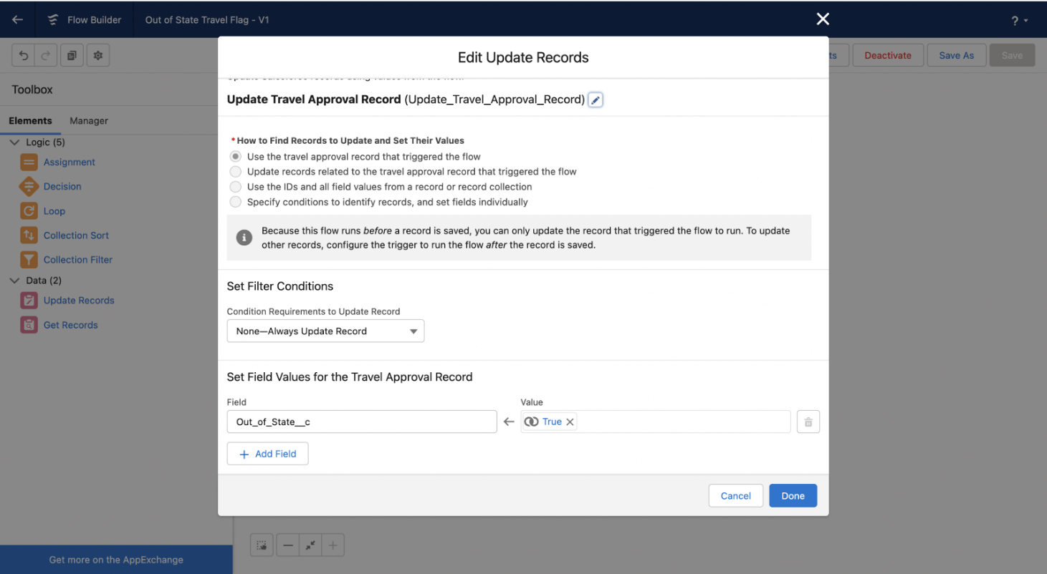
Updated the Travel Approval record when Travel is out of State.

Slide 23
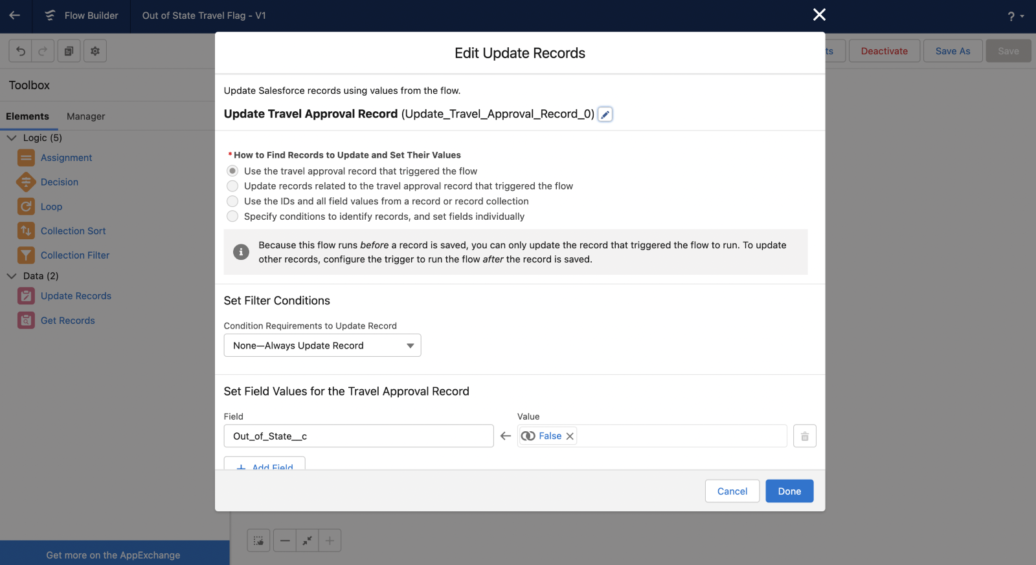
Updated the Travel Approval record when Travel is In State.

Slide 24
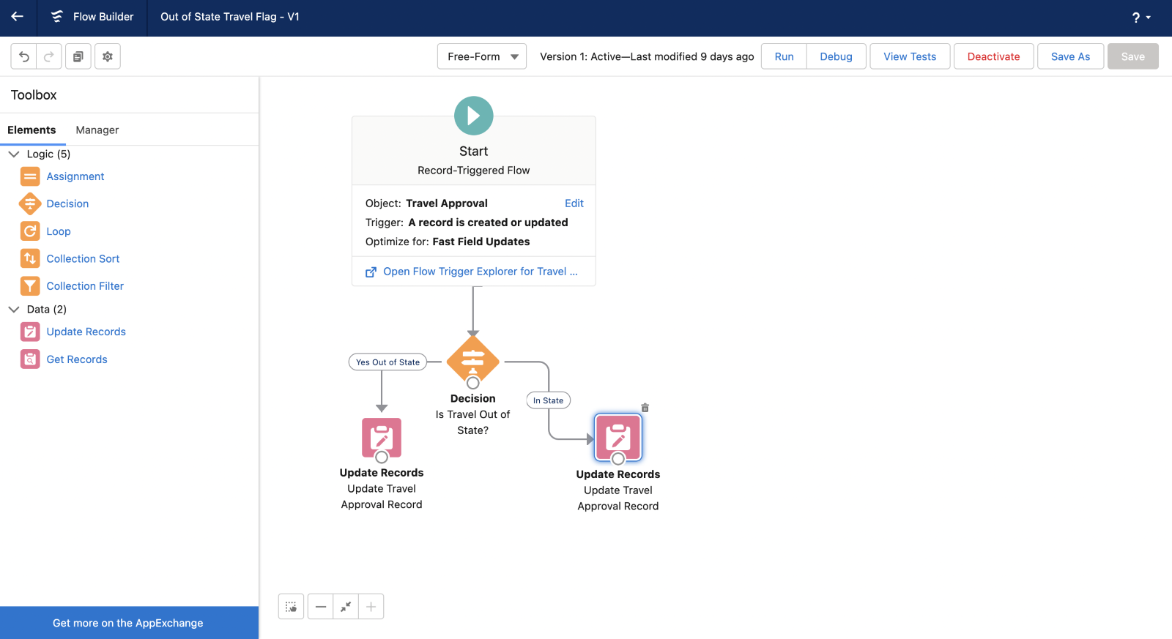
Overall Flow:

Slide 25
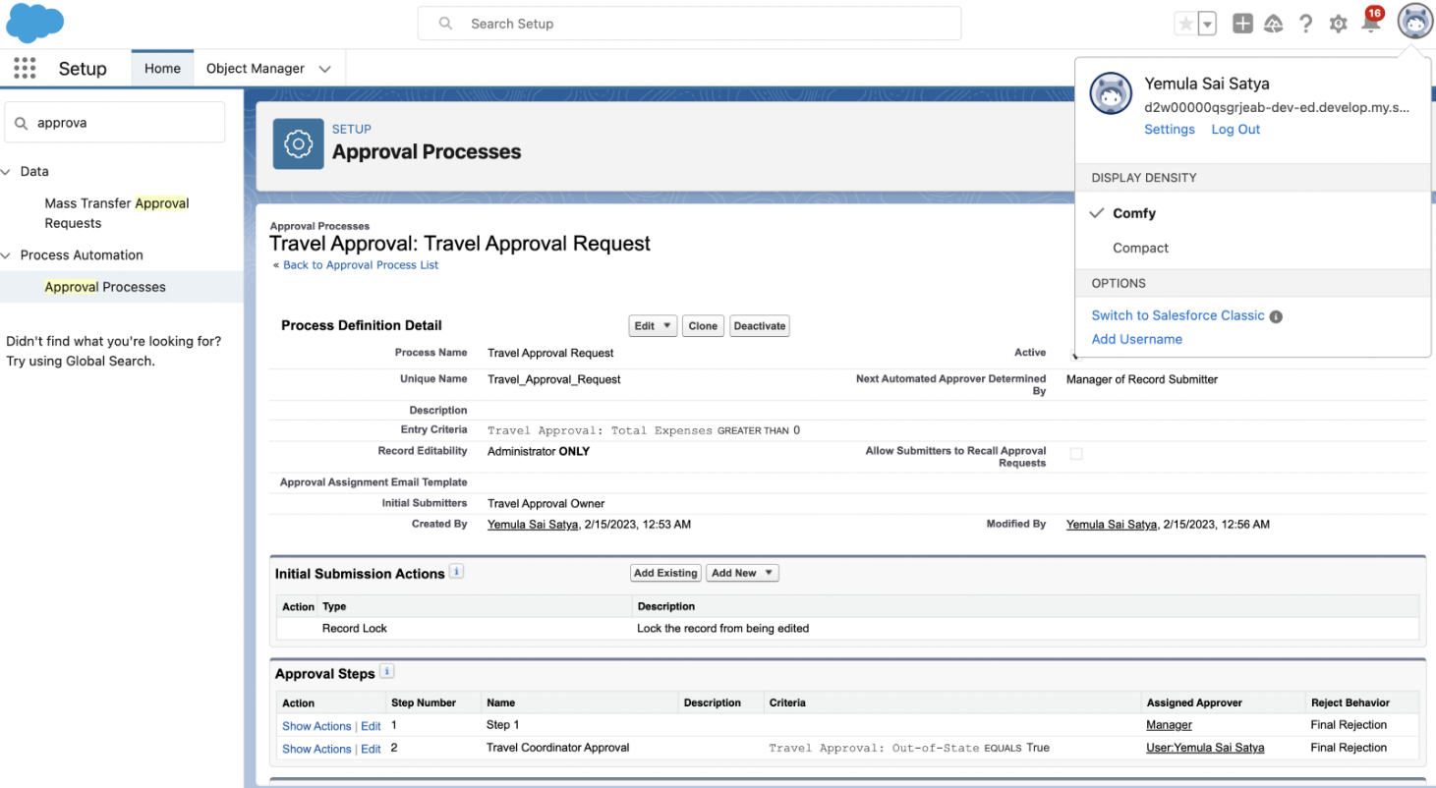
Created an Approval process for Travel Approval request.

Slide 26
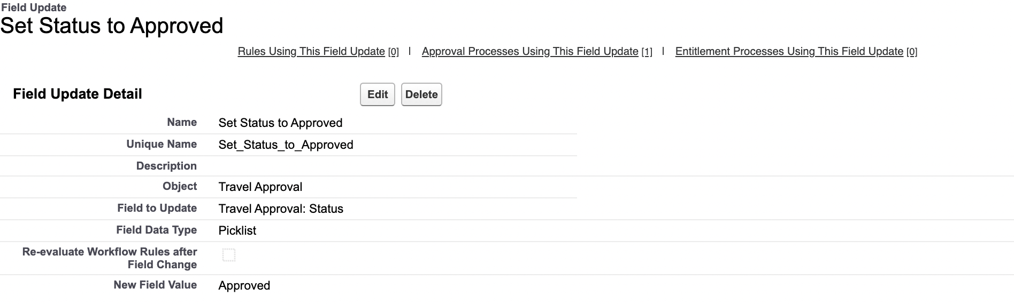
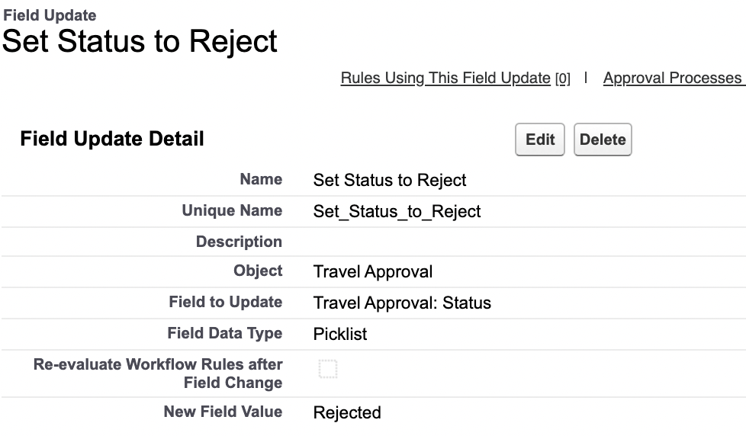
Created Final Approval and Rejection Actions.

Slide 27
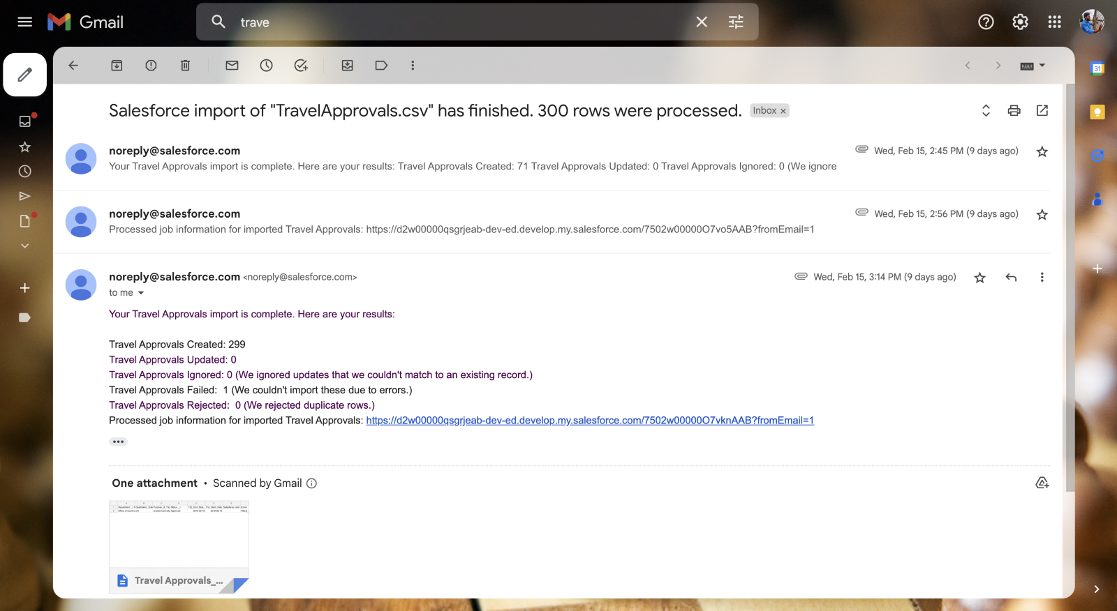
Imported Travel Approval Records Using Data Import Wizard.

Slide 28
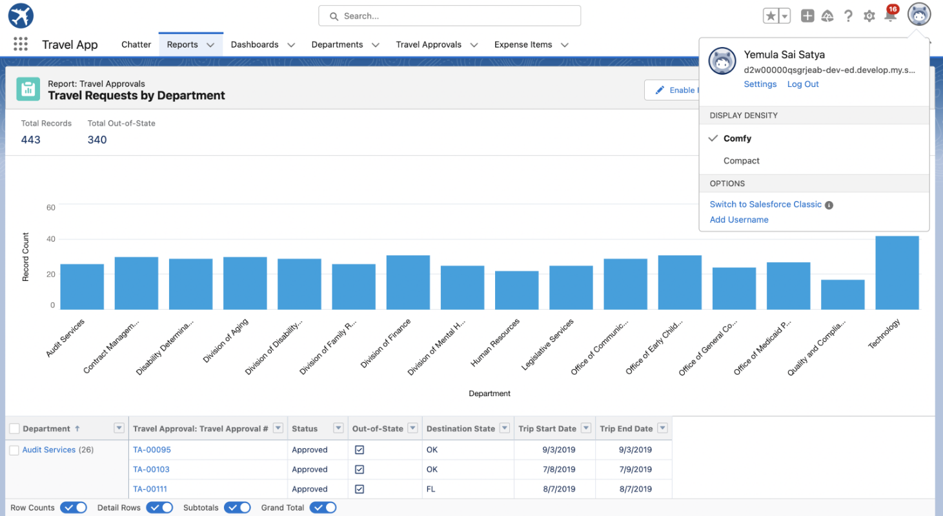
Created Travel Requests by Department Report.

Slide 29
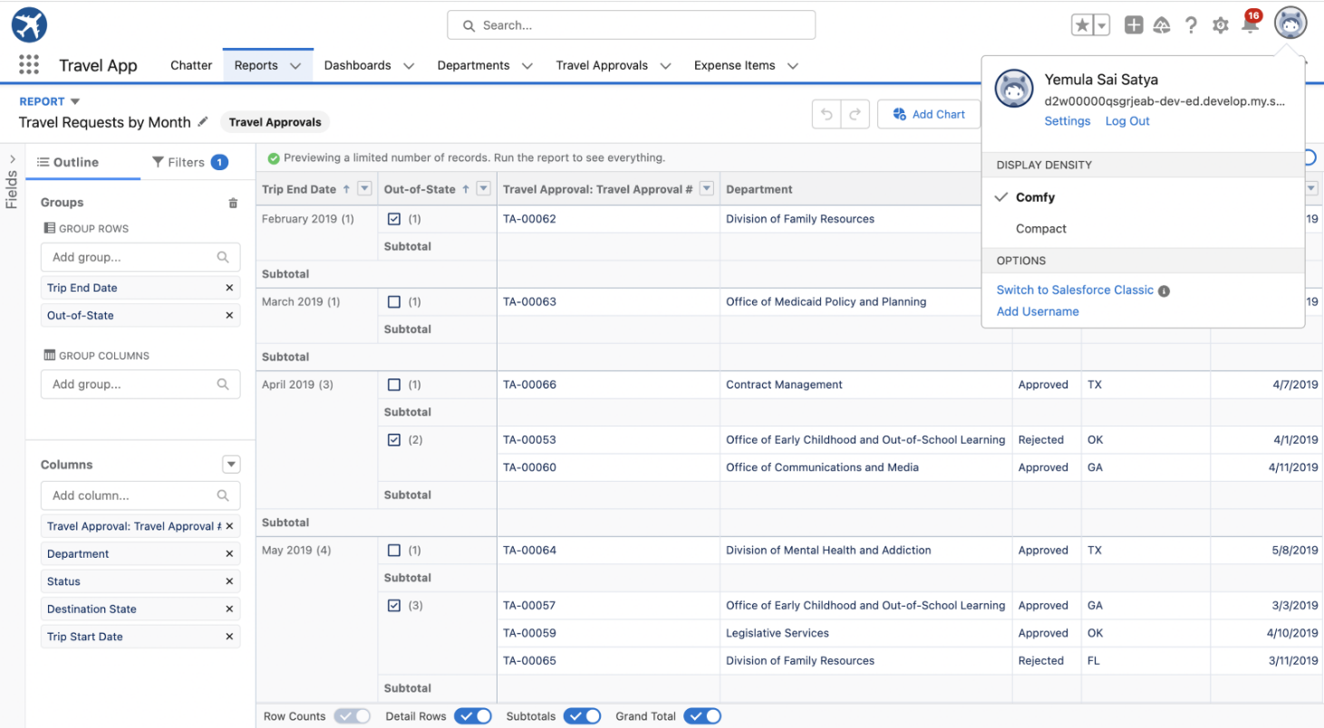
Created Travel Requests by Month Report.

Slide 30
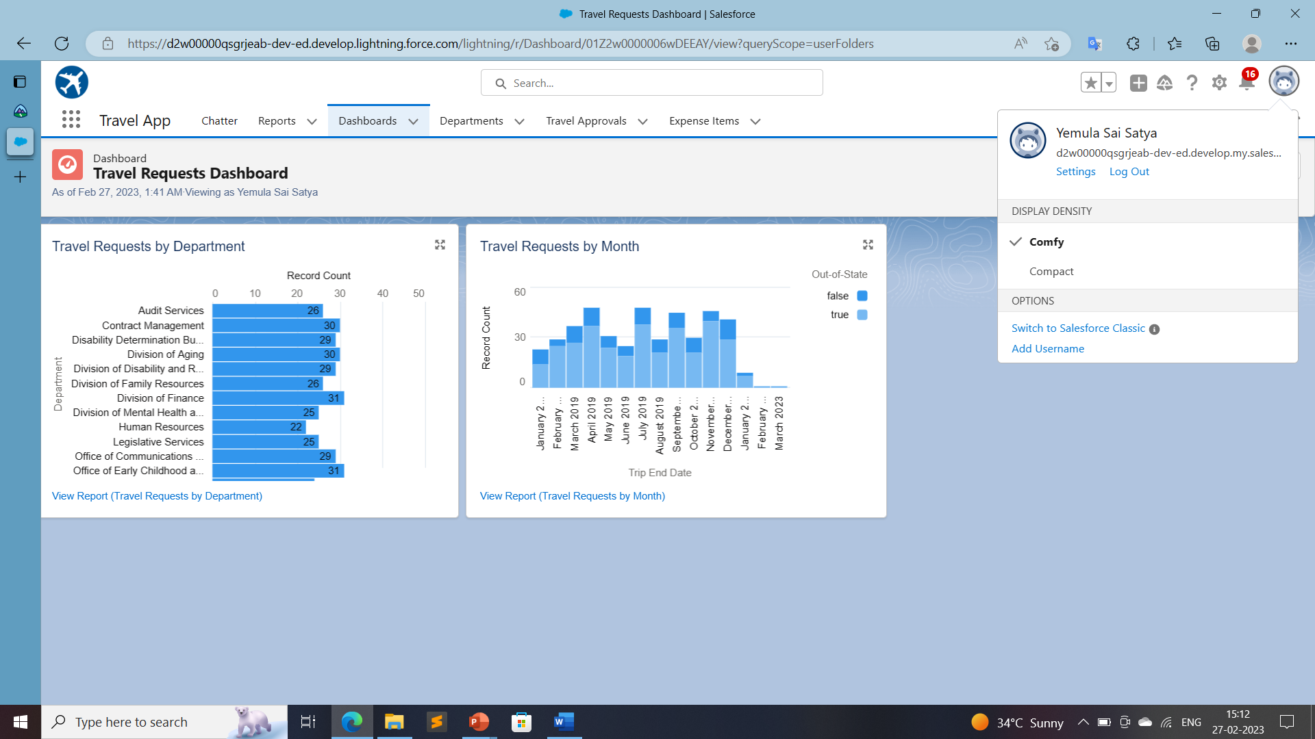
Created Travel Approvals Dashboard.

Slide 31
MODULE 3
This project module focuses on the coding approach to extend the functional capabilities of your custom App.

Slide 32
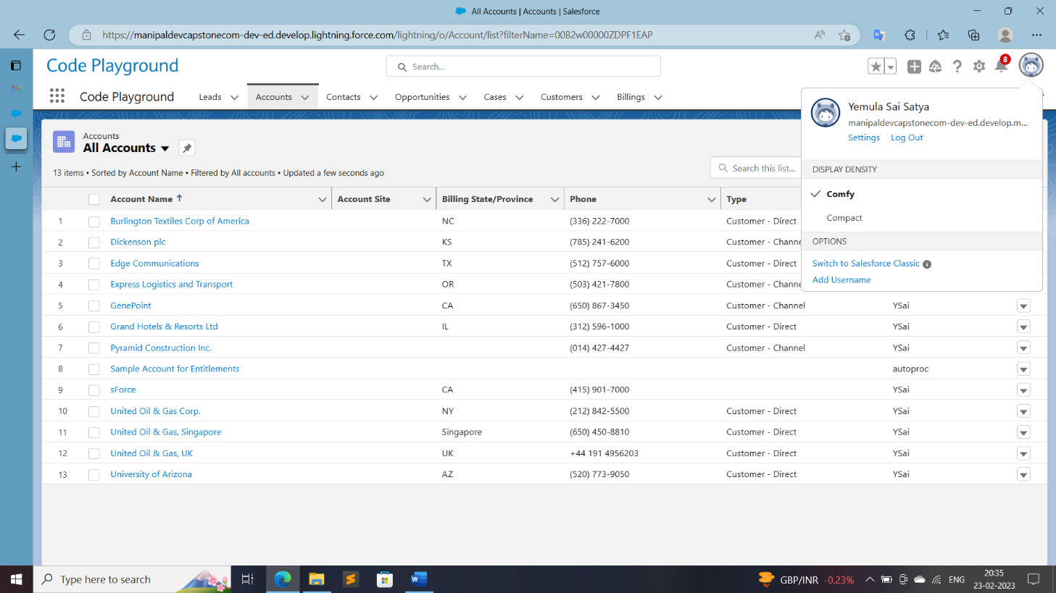
Exercise - 01 Creating Code Playground Lightning App with Lead, Account, Contact, Opportunity, Case to navigation profile as system admin.

Slide 33
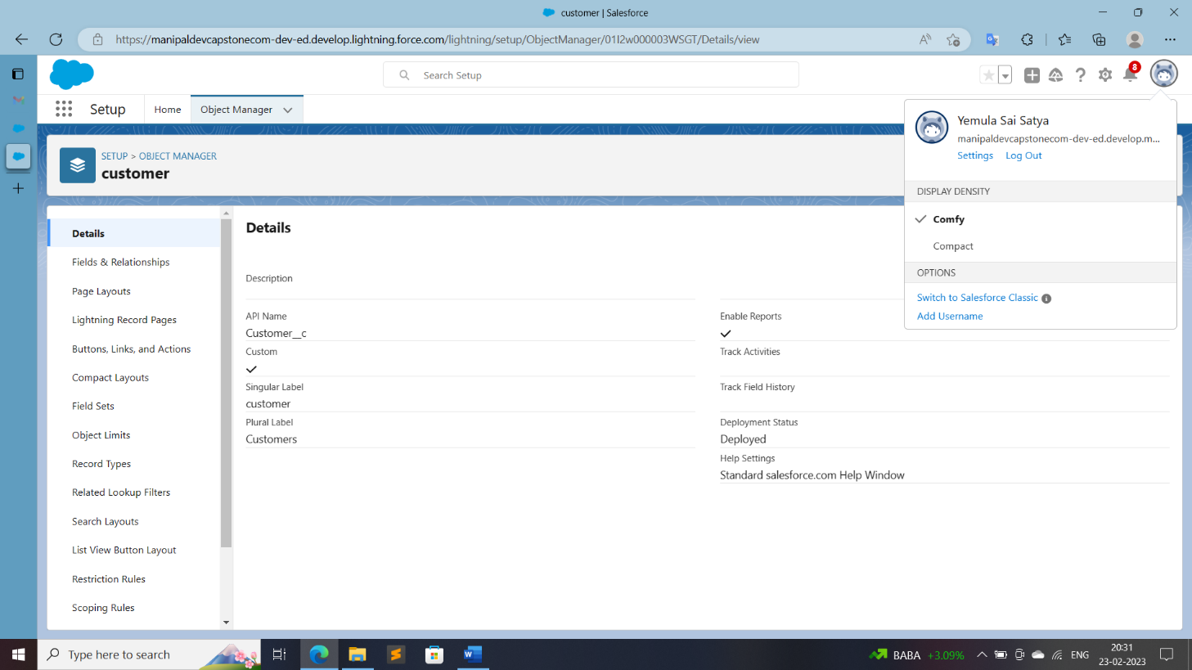
Created the Custom Object Customer as (customer) as there is already a Standard Object named Customer:

